Slide 1
Rain Prediction Comparative Analysis Through Multiple Model Building
CSE-3506 Essentials of Data Analytics
URMILA SINGH 18BCE1259
VIVEK GORANIA 18BCE1310

Slide 2

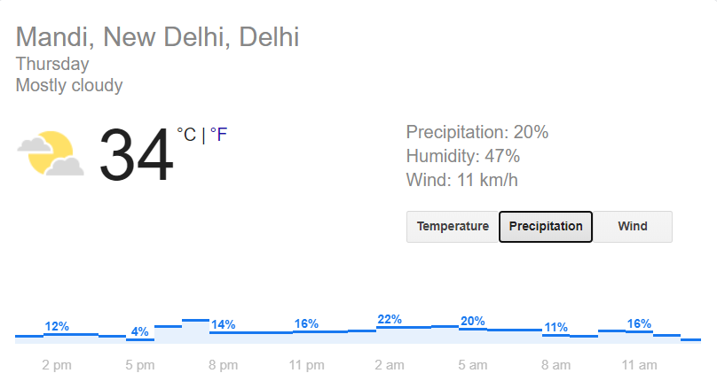
Objective of the Project
Rain Prediction Analysis
To predict whether it will rain in the forthcoming days or not. This will help to regulate open-ground activities and prevent unwanted loss of time and resources due to the unprecedented weather.

Slide 3
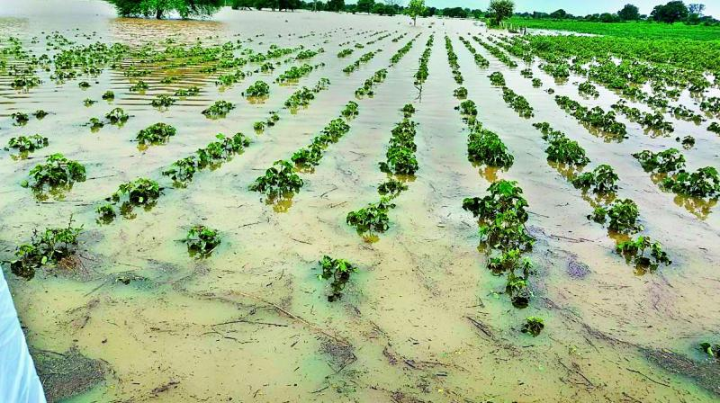
Motivation for Selecting the Dataset
Unseasonal rain and lack of rain is a major concern throughout the world. It has often posed as a grave issue during major outdoor events, especially sporting events.
To tackle this problem we created a model, Rain Prediction Analysis, primarily focused in Australia to decide if it will rain in the forthcoming days. The focus on Australia is in light of the recent Australian bushfires.
Notes:
Cricket matches, australia bush fire, farmers

Slide 4
Description of the Dataset
Rain Prediction Analysis
30, 843 - Rows
21 - Columns
Location
MinTemp
MaxTemp
Rainfall
WindGustDir
WindGustSpeed
WindDir9am, WindDir3pm
WindSpeed9am, WindSpeed3pm
Humidity9am, Humidity3pm
Pressure9am, Pressure3pm
Cloud9am, Cloud3pm
Temp9am, Temp3pm
RainToday
RISK_MM
RainTomorrow

Slide 5
Details of Data Pre-Processing
Rain Predictor Analysis
Data Cleaning
Removed NaN values
Filtered unwanted outliers
Data Reduction
Attribute Subset selection
Feature Encoding
Nominal - Categorical Encoding
Notes:
The App rating prediction data set had various text based data which was converted to numeric based data. The type of the app i.e. ‘free’ or ‘paid’ was converted to 1 or 2. Content rating of the app had different categories which was converted to a numerical value from 1 to 6. The categories column was given a numeric value from 1 to 28 as there were 28 different categories of apps. The size of the app column had text based data(‘varies with size’) this was replaced with the average size .

Slide 6
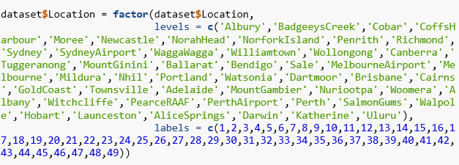
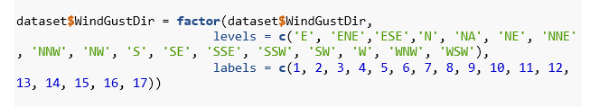
Details of Data Pre-Processing
Rain Prediction Analysis
Feature Encoding
Categorical Encoding
Data Cleaning
Removing the outliers using Z-score
Data Standardisation
Using MinMaxScaler
Notes:
The App rating prediction data set had various text based data which was converted to numeric based data. The type of the app i.e. ‘free’ or ‘paid’ was converted to 1 or 2. Content rating of the app had different categories which was converted to a numerical value from 1 to 6. The categories column was given a numeric value from 1 to 28 as there were 28 different categories of apps. The size of the app column had text based data(‘varies with size’) this was replaced with the average size .

Slide 7
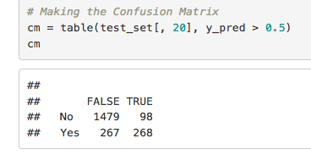
Overviews of Linear Models Used
Rain Prediction Analysis
Linear Regression is a linear approach to modelings the relationship between a scalar response (or dependent variable) and one or more explanatory variables (or independent variables).
Multiple Linear Regression, also known simply as multiple regression, is a statistical technique that uses several explanatory variables to predict the outcome of a response variable.
Initially, Logistic Regression model was applied on this dataset. Logistic Regression preserves the marginal probabilities of the training data.
In Support Vector Machine (SVM) we plot each data item as a point in a n-dimensional space with the value of each feature being the value of a particular coordinate. Then, we perform classification by finding the hyper-plane that differentiates the two classes very well.

Slide 8
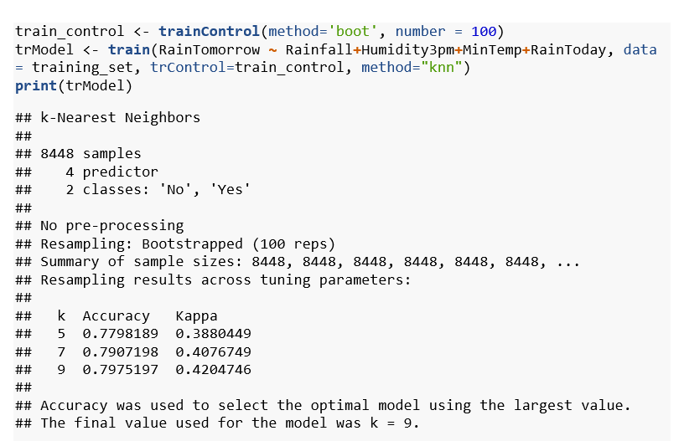
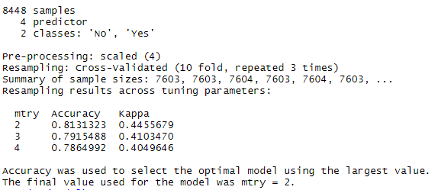
Details of Validation Tests
Bootstrap
K-Fold Cross Validation
The final value used for the model was mtry = 2
The final value used for the model was k = 9

Slide 9
Details of Methodology Used for Model Selection and Regularisation
Rain Prediction Analysis
A linear regression model was applied. As it didn't not give a satisfactory result, multiple linear regression was implemented.
Since, the linear models such as Logistic Regression and SVM (Linear Kernel) did not provide satisfactory results, the exploration of non-linear models was carried out.
These models included Neural Nets, Random Forest and Decision Tree Classifier.

Slide 10
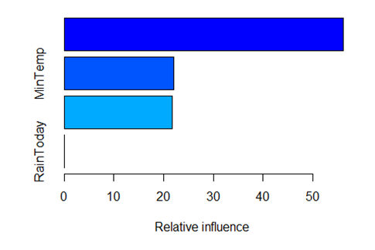
Analysis of Performance of Linear Models
Rain Prediction Analysis
On the application of Linear Regression, the accuracy came out to be 42%
Then, Multiple Linear Regression was applied, which resulted in a unsatisfactory accuracy of 47%
Initial application of Logistic regression led to an accuracy of 53%
Then, another linear model, SVM (Linear Kernel), was explored in hopes of a good accuracy. However, it only resulted in an accuracy score of 79%
Thus, the shift to non-linear models was made.

Slide 11
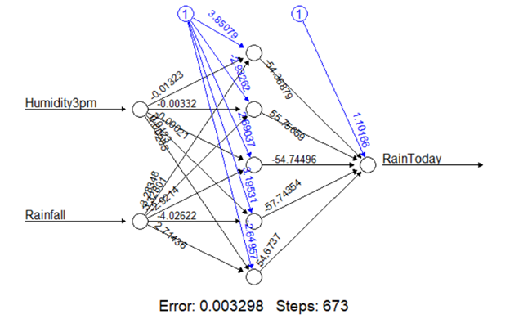
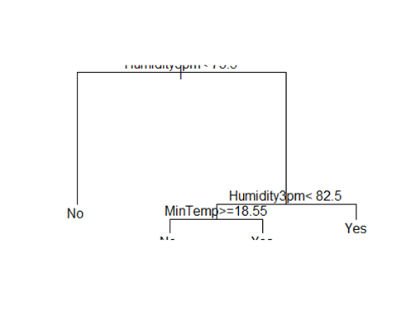
Overview of Non-Linear Models Used
Neural Net - Artificial neural networks or connectionist systems are vaguely inspired by the biological neural networks that constitute animal brains. Such systems "learn" to perform tasks by considering examples, generally without being programmed with task-specific rules.
Decision Tree Classifier - Decision tree learning is one of the predictive modelling approaches used in machine learning. It uses a decision tree to go from observations about an item to conclusions about the item's target value. Tree models where the target variable can take a discrete set of values are called classification trees.

Slide 12
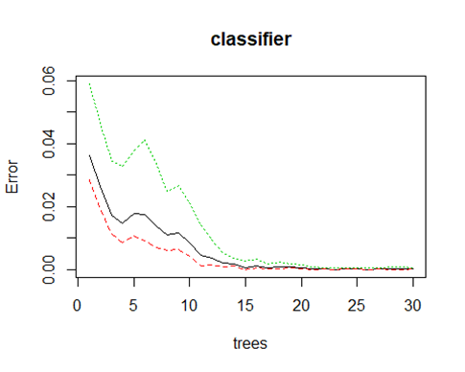
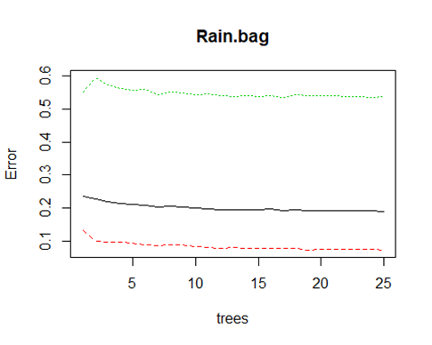
Overview of Non-Linear Models Used
Random Forest - Random decision forests are an ensemble learning method for classification and regression that operate by constructing a multitude of decision trees at training time and outputting the class that is the mode of the classes, or mean prediction of the individual trees.
Boosting - A natural way to reduce the variance and hence increase the prediction accuracy of a statistical learning method is to take many training sets from the population, build a separate prediction model using each training set, and average the resulting predictions.
Bagging - We ﬁt a decision tree to the residuals from the model. That is, we ﬁt a tree using the current residuals, rather than the outcome, Y, as the response. We then add this new decision tree into the ﬁtted function in order to update the residuals.

Slide 13
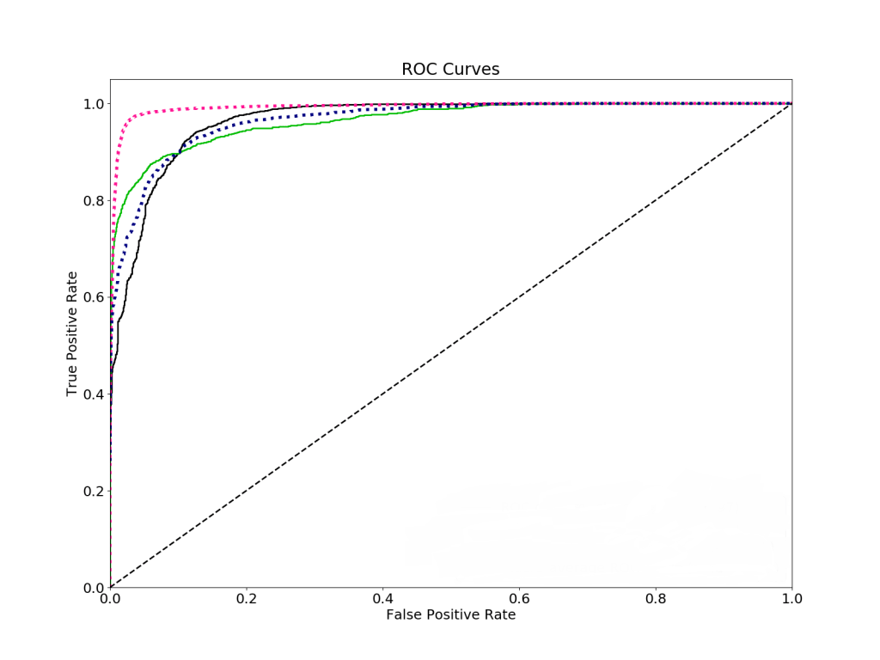
ROC Curve

Slide 14
Model Recommendation
(Which is the best and why?)
For Rain Prediction Analysis, Neural Net and Random Forest models are recommended.
Method | Accuracy
Linear & Multiple Regression | 43% , 47%
Logistic Regression | 53.8%
Neural Net | 100%
Decision Tree Classifier | 82.3%
Random Forest | 100%
Support Vector Machine | 82.43%
Boosting | 81.81%
Bagging | 81.03%

Slide 15
Thank you
Vivek Gorania
Urmila Singh

